Slide 1

Department of Mechanical Engineering,
A
Presentation
on
“DEVELOPMENT OF STRIP CUTTING MACHINE USING REVERSE ENGINEERING”
Mini Project Guide
Prof. A.L. MANGRULKAR
Presented By:
1) AMAN BADDELA 403
2) TEJAS BHAGAT 405
3) PRATHAM GURAV 418
4) PRANAY KATKE 426

Slide 2
CONTENTS
Sr. No. | Contents
01 | Introduction
02 | Review of the Literature
03 | Overall Conclusion from Literature Review
04 | Gap Analysis from Literature Review
05 | Methodology
06 | Schematic Setup for Experimentation
07 | Work done till date
08 | References
RGIT, Andheri

Slide 3
INTRODUCTION
The project is based on simple cutting mechanism where, a long sheet is being cut into thin strips, which will later be used for biomedical application.
In this project we used the initials steps of the reverse engineering to get the dimentions and further used to generate CAD model.
The challenge was to make the machine more efficient and create minimum waste.
We made a visit to the Industry located at Pune.

Slide 4
REVIEW OF LITERATURE
Sr. no. | Authors | Methodology | Conclusion
[1] | Kishor Shelke et al (2018) | APPLICATION OF REVERSE ENGINEERING FOR CONVERTING CARTESIAN COORDINATE SYSTEM INTO LASER CUTTING MACHINE i.Optimization and Design of a Laser-Cutting Machine using Delta Robot by B.Moharana et al ii. Review on Heat affected Zones, Cut Quality and Comparative Study iii. Study of Arduino Controlled Robotic System | With the help of reverse engineering the Cartesian coordinate system is successfully converted into laser cutting machine. It is concluded that the laser cutting machine is working properly and able to cut the non metals with good accuracy
[2] | N. Singh (2008) | REVERSE ENGINEERING i. Scanning Phase ii. Point Processing Phase | Studied about its role in the development , refinement and modification in existing design of product.

Slide 5
[3] | Prof.N.S. Pohokar et al (2013) | Application Of Coordinate Measuring Machine In Reverse Engineering: A Case Study i. Scanning the physical part with the help of CMM. ii. To obta0in point cloud data of a component through CMM scanning. iii. To export this cloud point data of CMM (PCDMIS software) to the modeling software (preparation of IGES, STET, STL file). iv. To prepare a CAD model & obtain the various dimensions of the component. v. Importing the CAD model to the PCDMIS software & preparing inspection program for error analysis. | The above study shows that using Coordinate Measuring Machine helps to get the unknown details of any component. The intricate dimensions which are not possible to measure by any other method can be measured easily. The design process can also be simplified and cost incurred in designing is also minimises. Also the inspection activity is simplified with the help of CMM machine.
[4] | Vishesh Jain et al(2014) | Functional Reverse Engineering for Mechanical Components i.Product Dissection ii.Measurements with Rough Drawing. iii. 3D Modelling | . Product dissection along with the creation of rough drawings proves a powerful technique for grasping engineering and design. The rough drawing serves a great purpose while creating their 3D model on any CAD software.

Slide 6
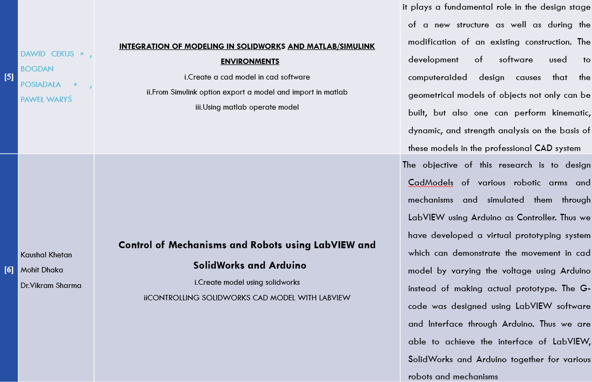
(2014)
(2016)

Slide 7
OVERALL CONCLUSION FROM LITERATURE REVIEW
With the help of reverse engineering the Cartesian coordinate system is successfully converted into laser cutting machine. It is concluded that the laser cutting machine is working properly and able to cut the non metals with good accuracy.(International Research Journal of Engineering and Technology (IRJET) e-ISSN: 2395-0056 Volume: 05 Issue: 04 | Apr-2018)
Studied the reverse engineering process, and its role in the development, refinement and modifications in the existing design of product. The various stages involved in reverse engineering, and its applications in different fields have been discussed. A brief historical events using reverse engineering technique.(N. Singh, IJAERS,2012).
In this work, Reverse Engineering technique is used gathering scientific knowledge about a part by physically examining it with the help of Coordinate Measuring Machine (CMM).(International Journal of Engineering Research & Technology (IJERT) Vol. 2 Issue 5, May – 2013)
Reverse engineering of the subject without using coordinate measuring machine proves a great tool to provide the user with 3 great treats of an engineer which are visual feedback, curiosity, proficiency and manual dexterity in the use.(Vishesh Jain et al, IJAME-2014)
RGIT, Andheri

Slide 8
GAP ANALYSIS
The existing machine was bulky, expensive, and time required to design and fabricate is more.
By reading and learning about reverse engineering and we are looking forward to create solutions by making it an efficient and durable machine and cost effective.
As we know bio-medical engineering field ranges from biological equipment to micro implant machines. We as a team have future goal of creating industrial slicing machine which has its major role in this respective field.
RGIT, Andheri

Slide 9
METHODOLOGY
Physical Model
Obtained dimensions
Study of components
CAD Model
Animation
Integration
Testing
Final Machine Simulation
RGIT, Andheri

Slide 10
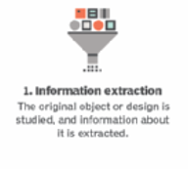
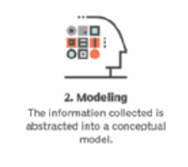
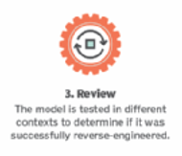

Slide 11
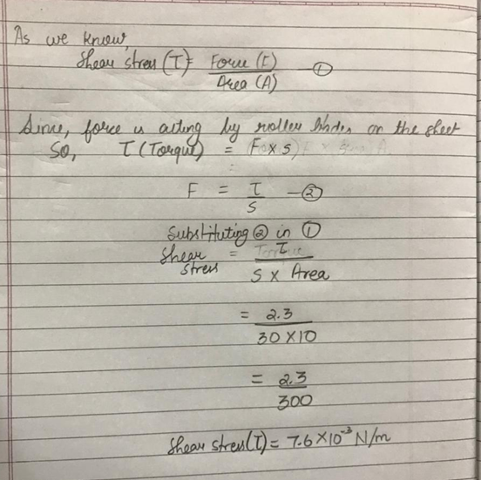
WORKING PRINCIPLE
SHEAR STRESS
Shear stress is the component of stress coplanar with a material cross section. It arises from the shear force, the component of force vector parallel to the material cross section. Normal stress, on the other hand, arises from the force vector component perpendicular to the material cross section on which it acts.
Common symbols | τ
SI unit | pascal
Derivations from other quantities | τ = F/A

Slide 12
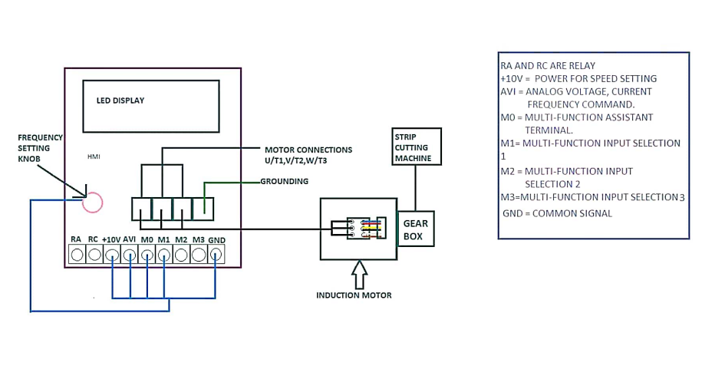
CIRCUIT DIAGRAM OF STRIP CUTTING MACHINE

Slide 13
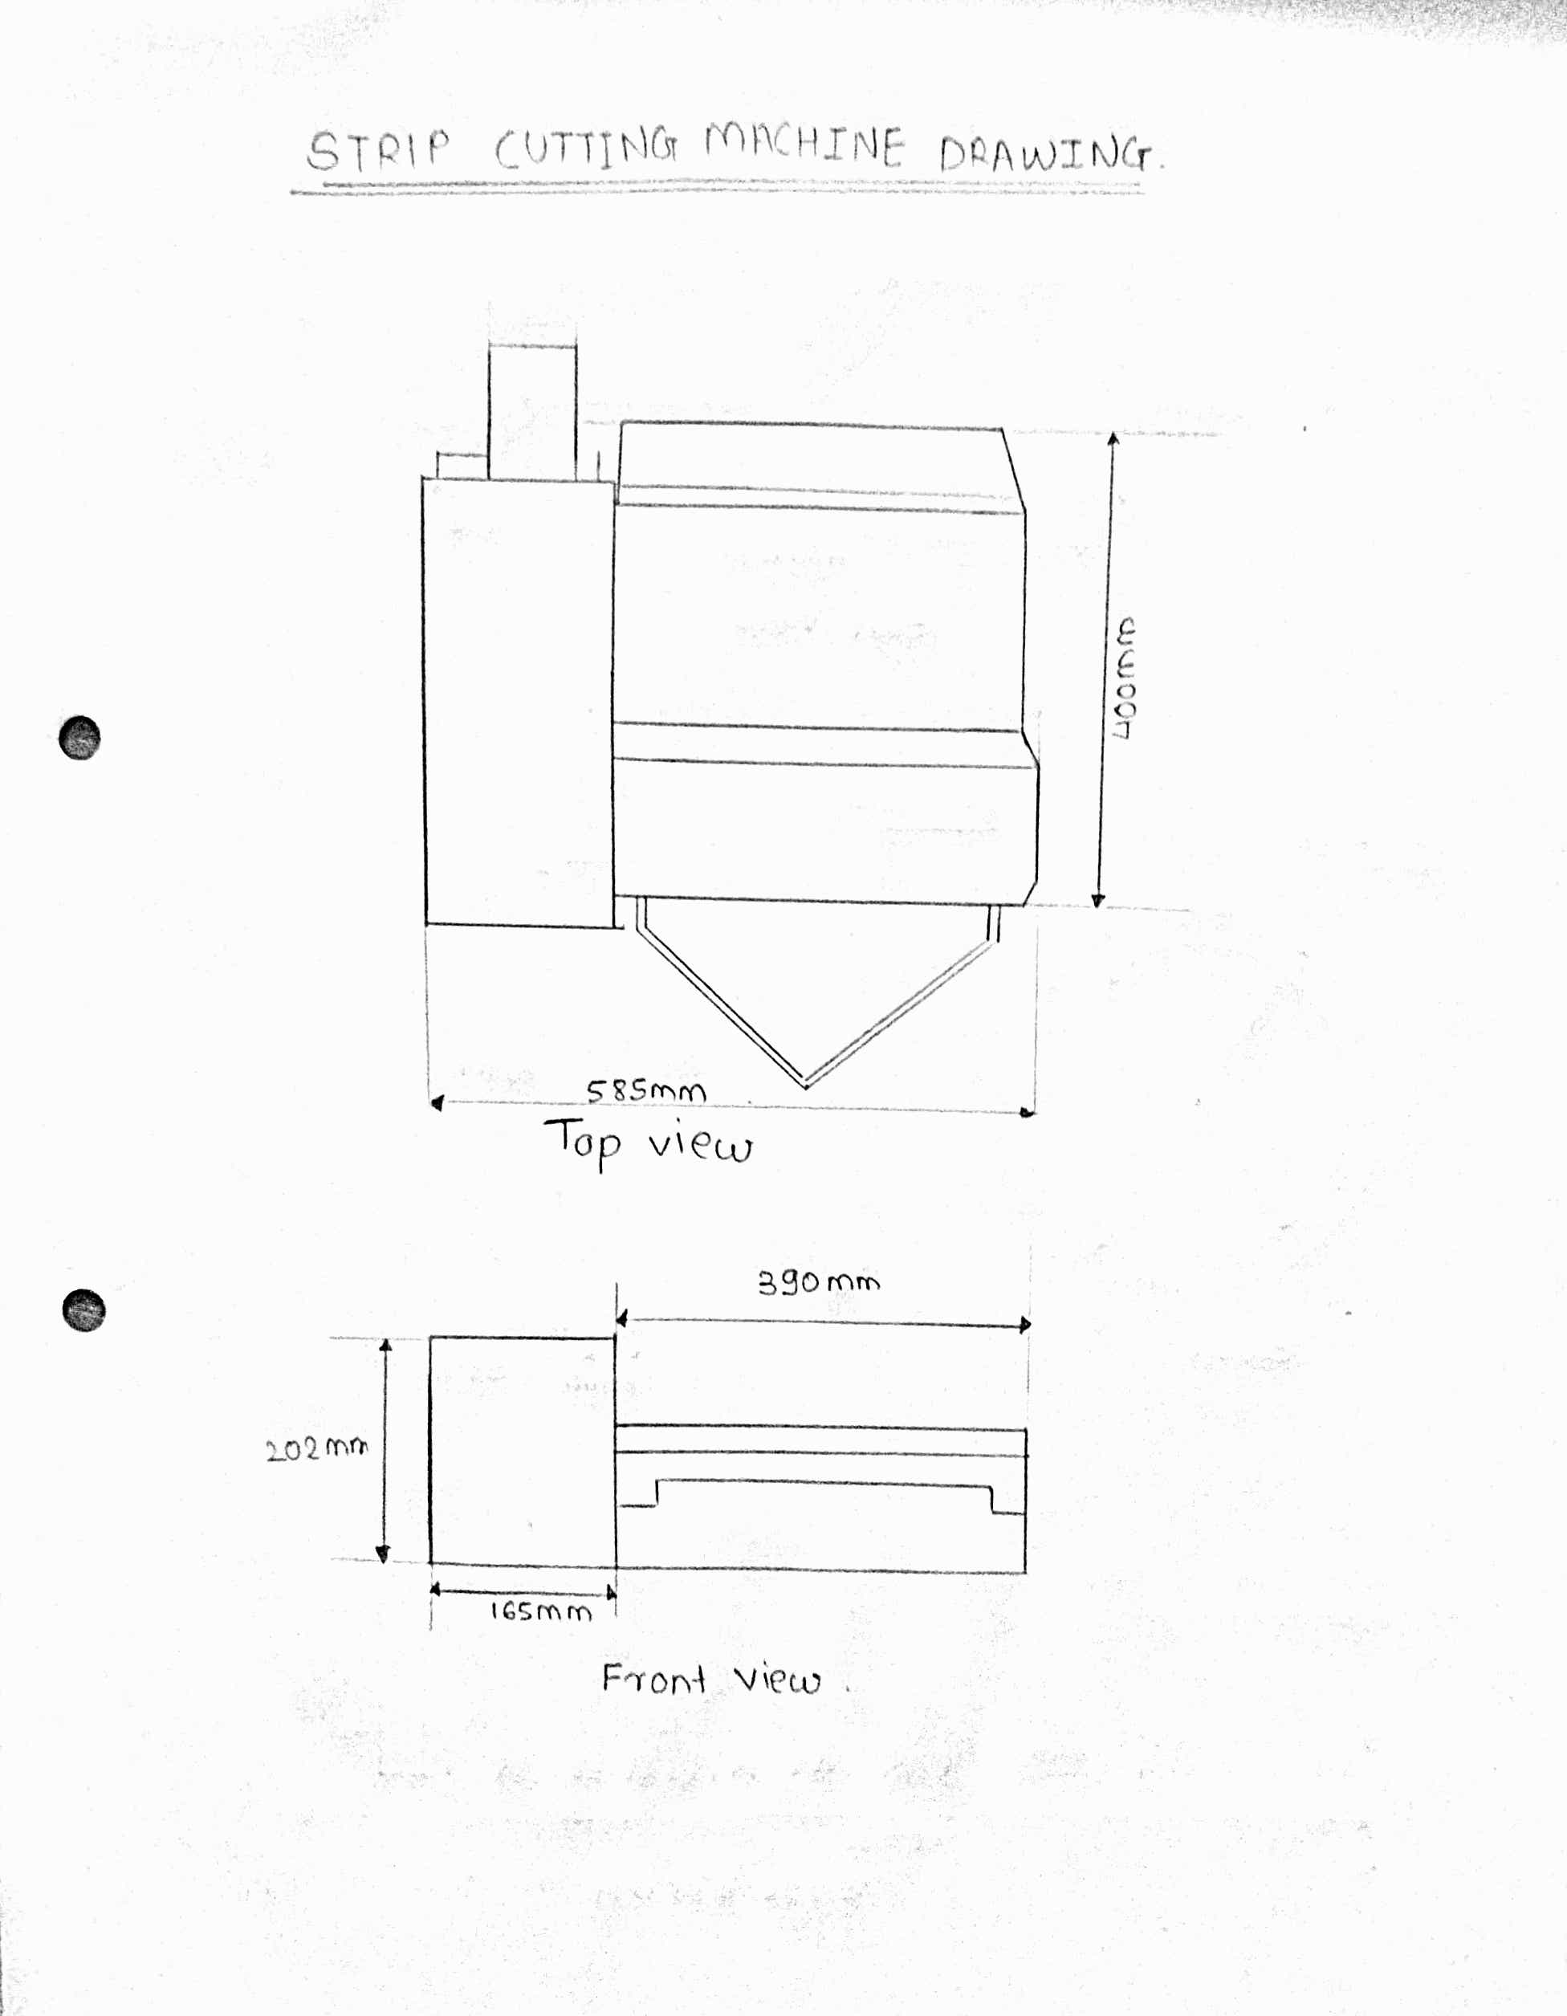
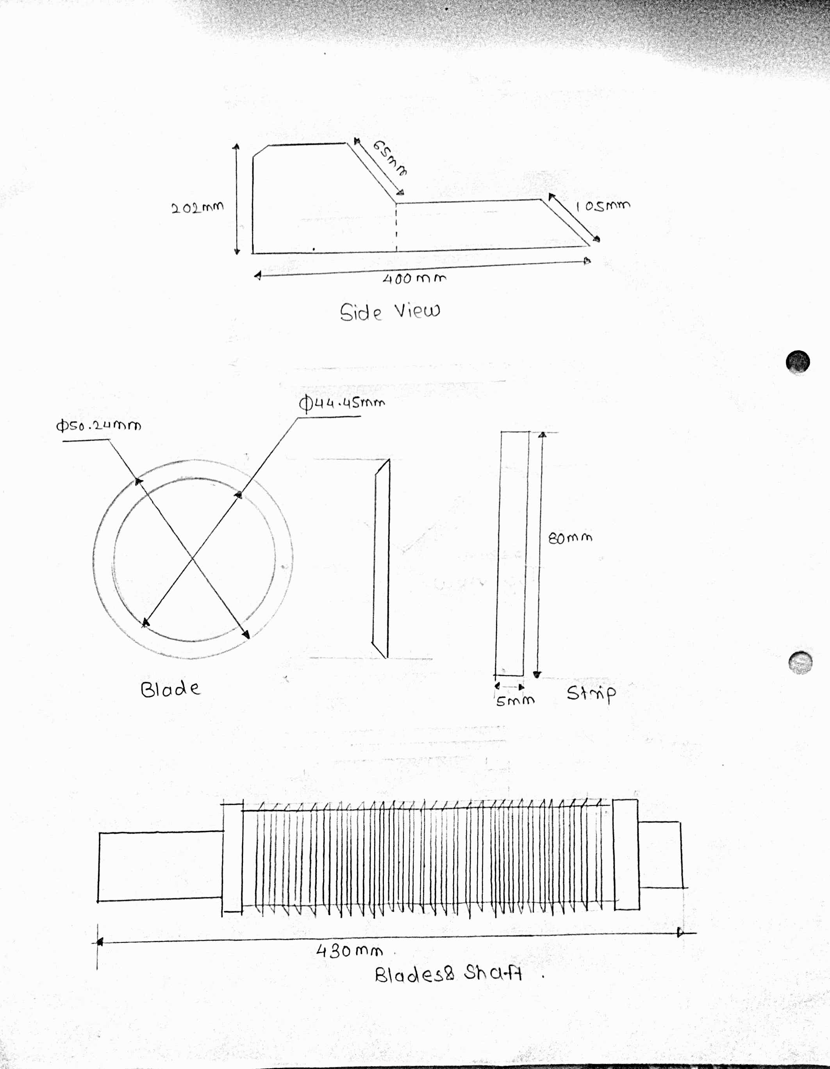
STRIP CUTTING MACHINE DRAWING

Slide 14
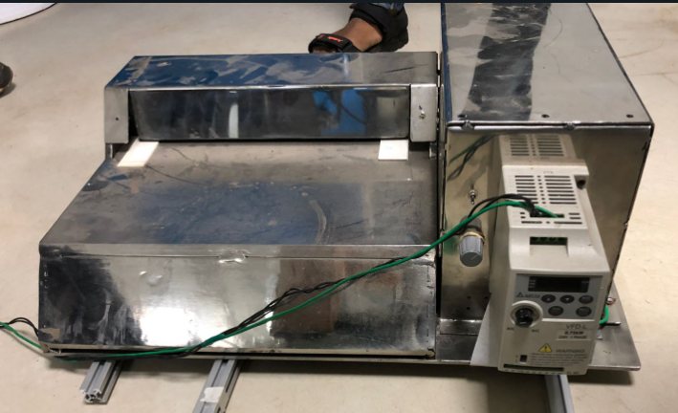
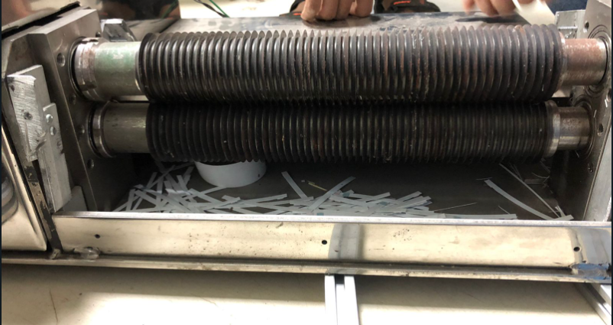
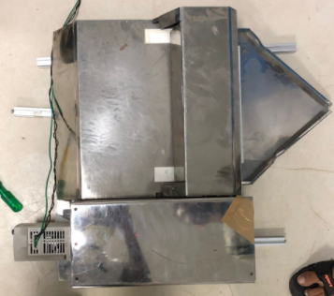
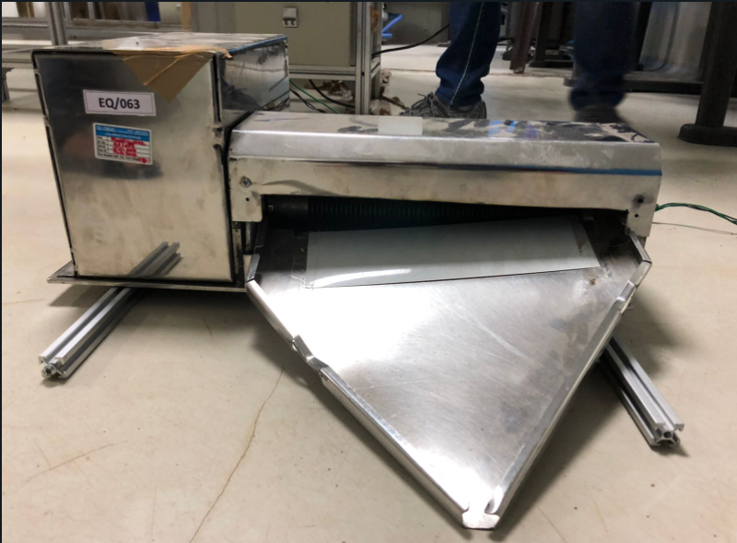

Slide 15
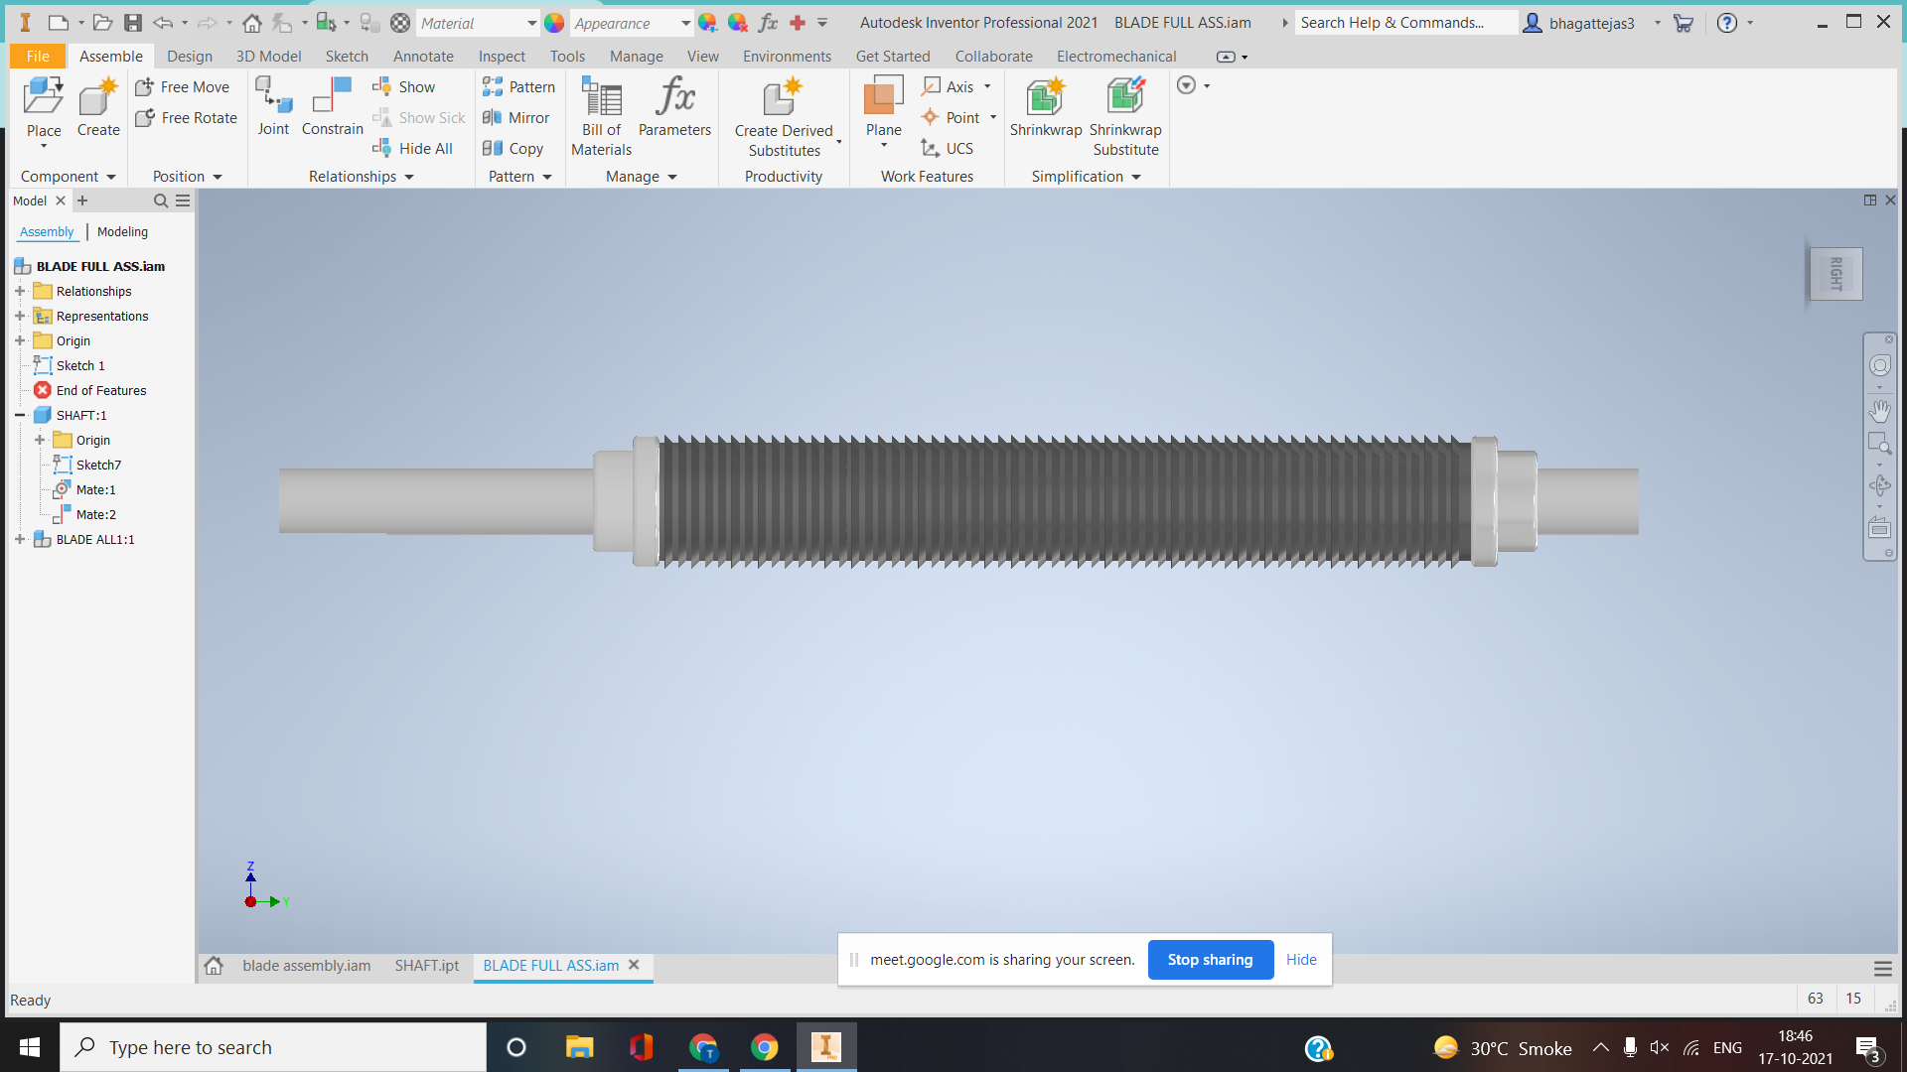
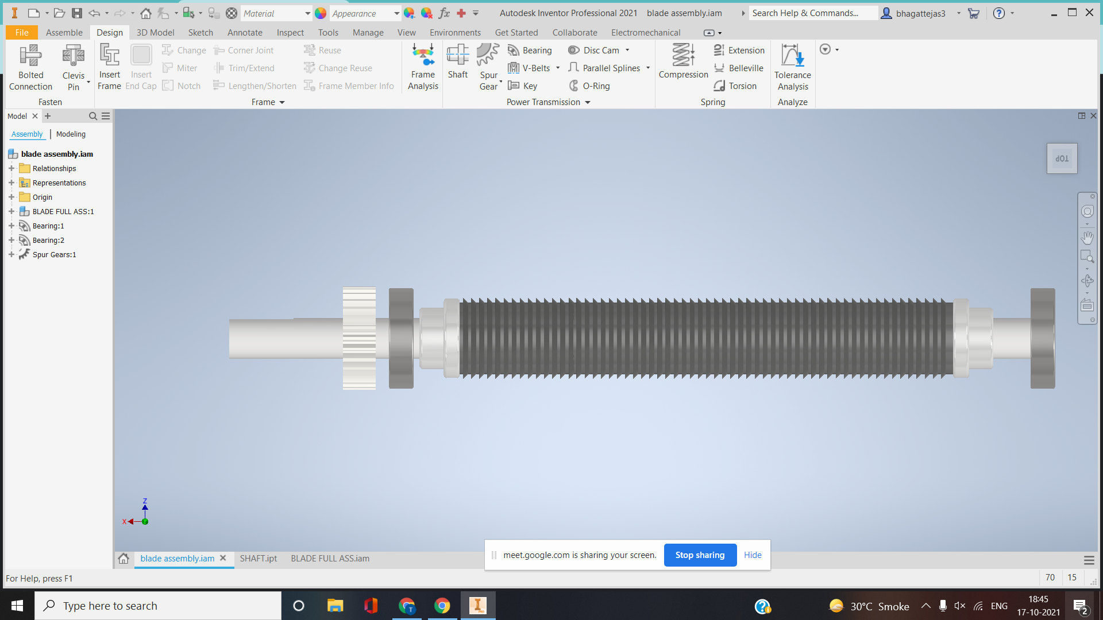
Roller Blades

Slide 16
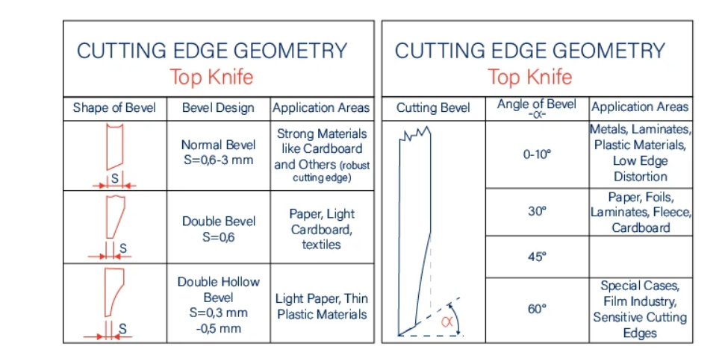

Slide 17
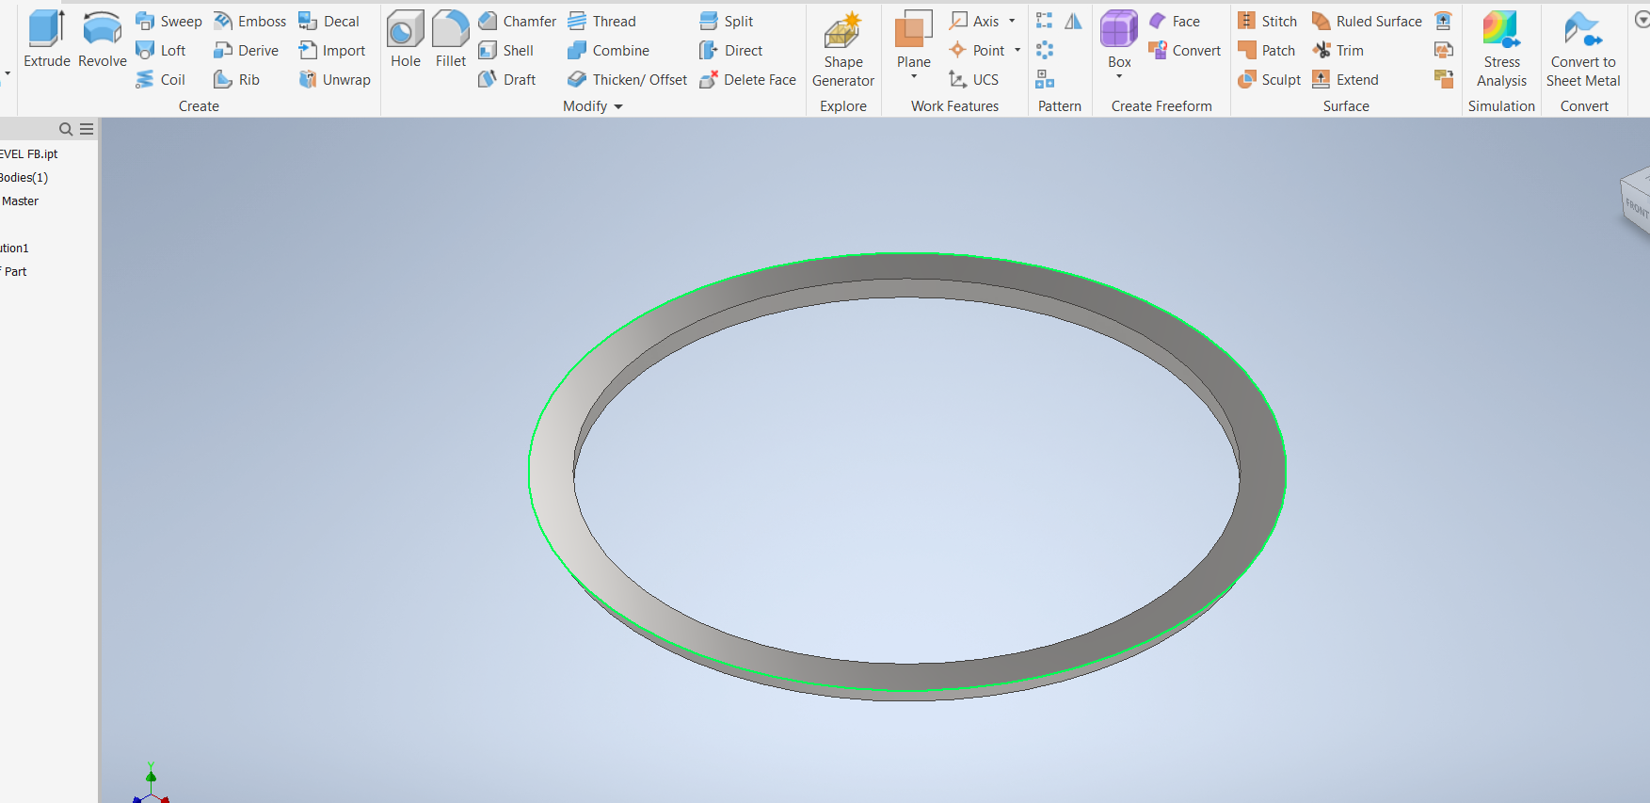
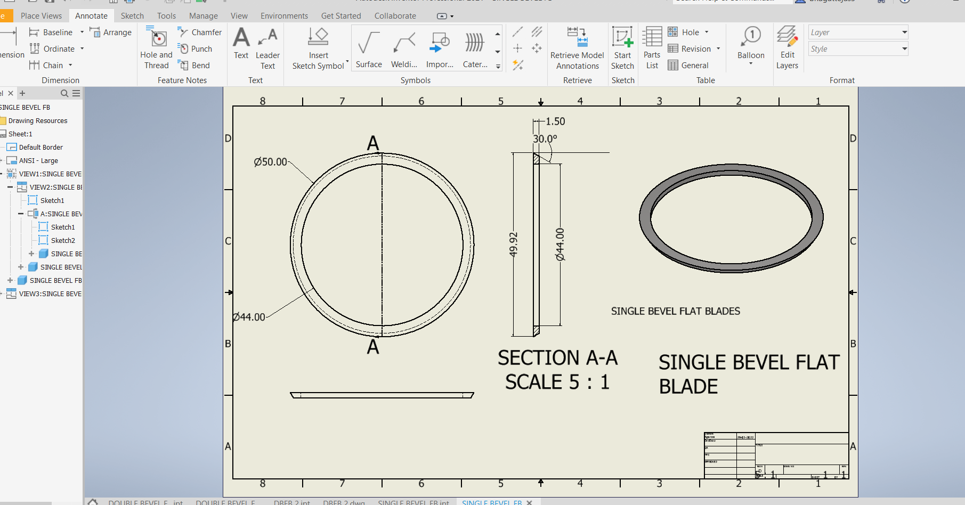
SINGLE BEVEL FLAT BLADE
BEVEL ANGLE = 30 degrees

Slide 18
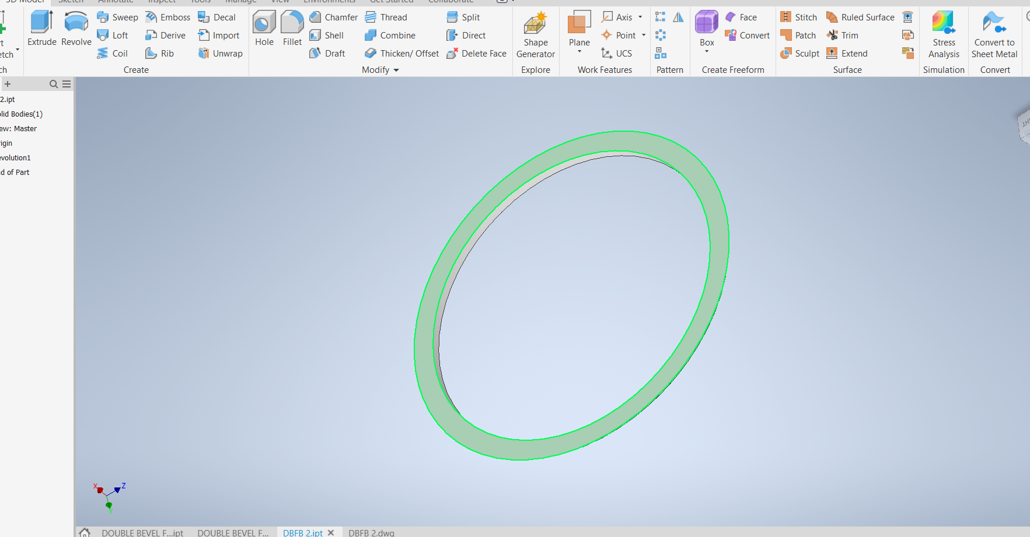
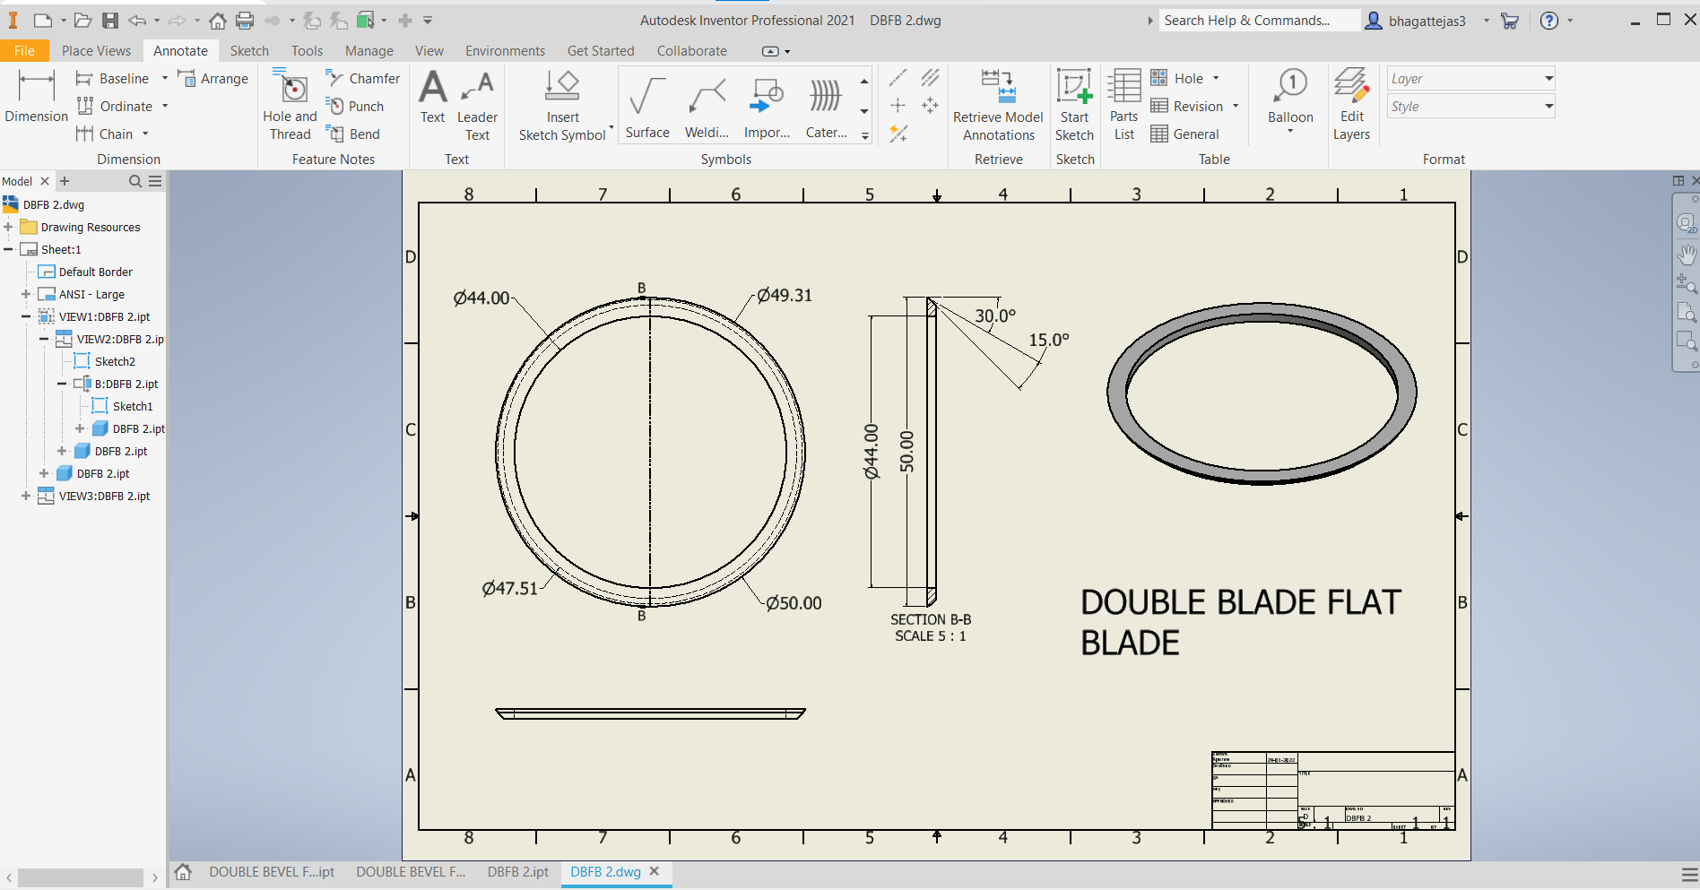
DOUBLE BEVEL FLAT BLADE
PRIMARY GRIND ANGLE=30 degrees
(SHEAR ANGLE , SLITTER ANGLE)
SECONDARY GRIND ANGLE=15 degrees
(RELIEF GRIND )
RIM WIDTH=0.6mm

Slide 19
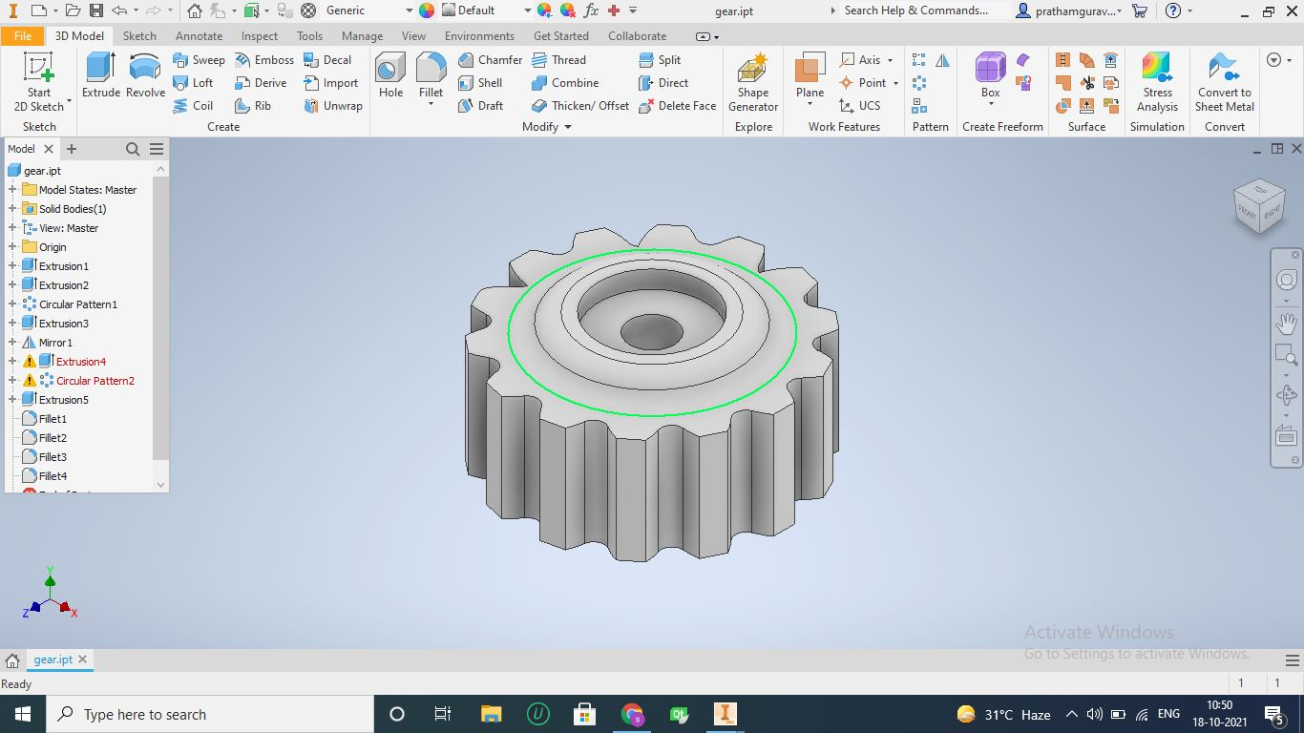
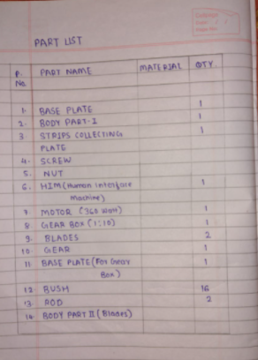
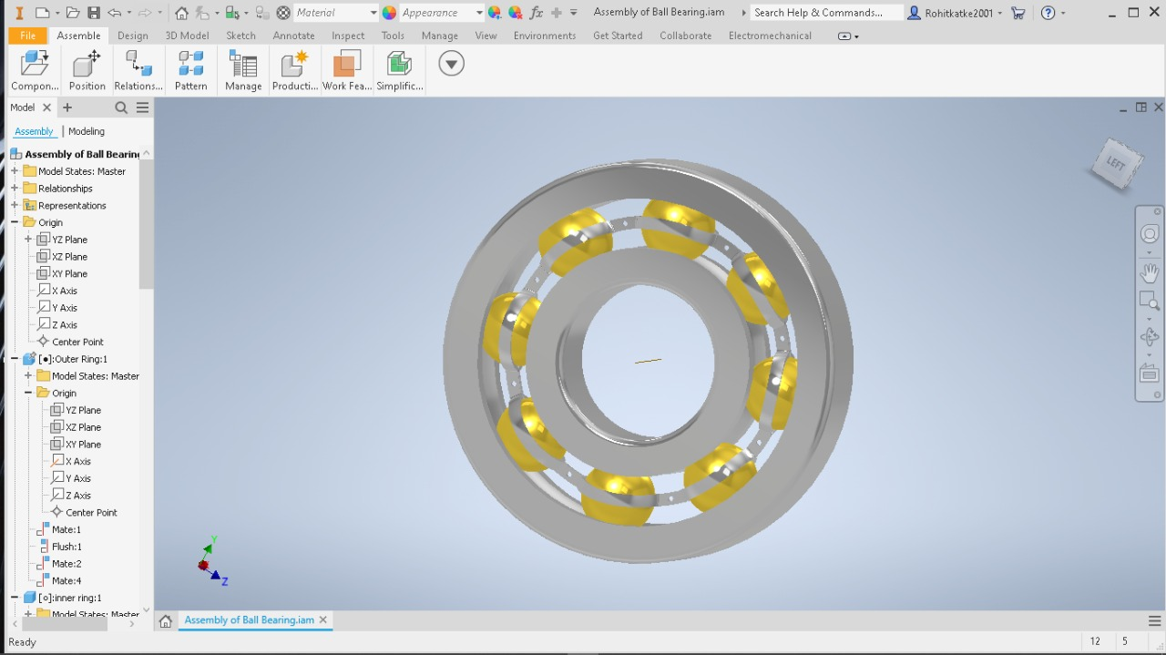
Spur Gear
Ball Bearing

Slide 20
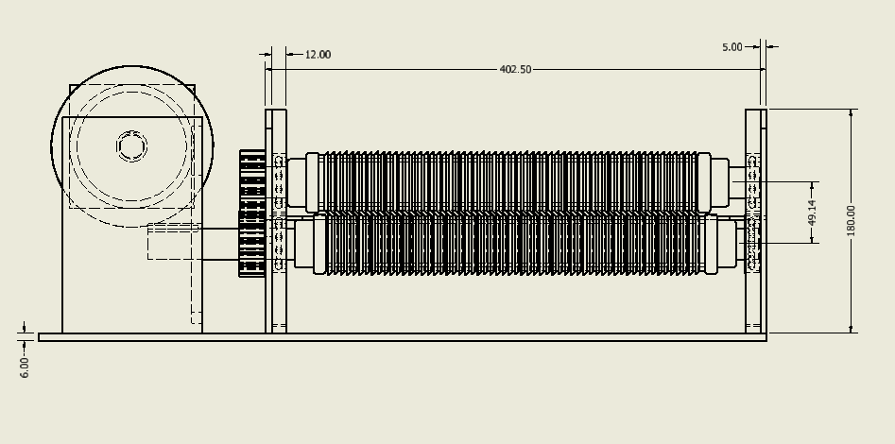

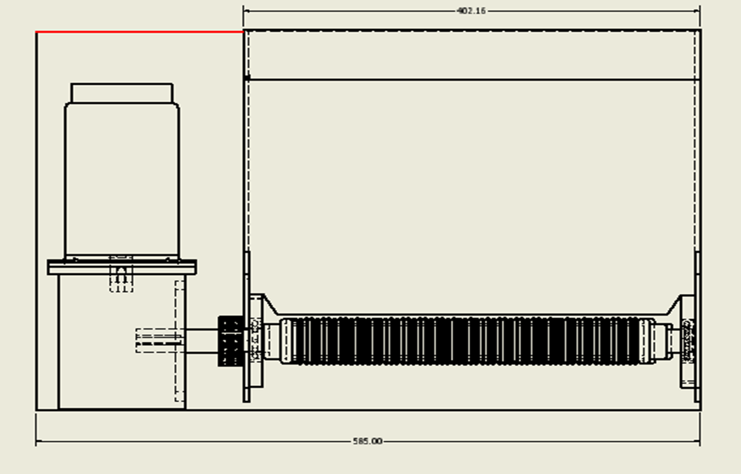
FRONT VIEW

Slide 21
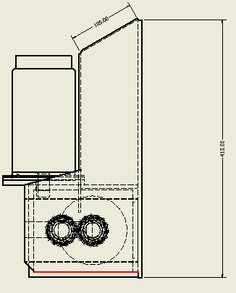
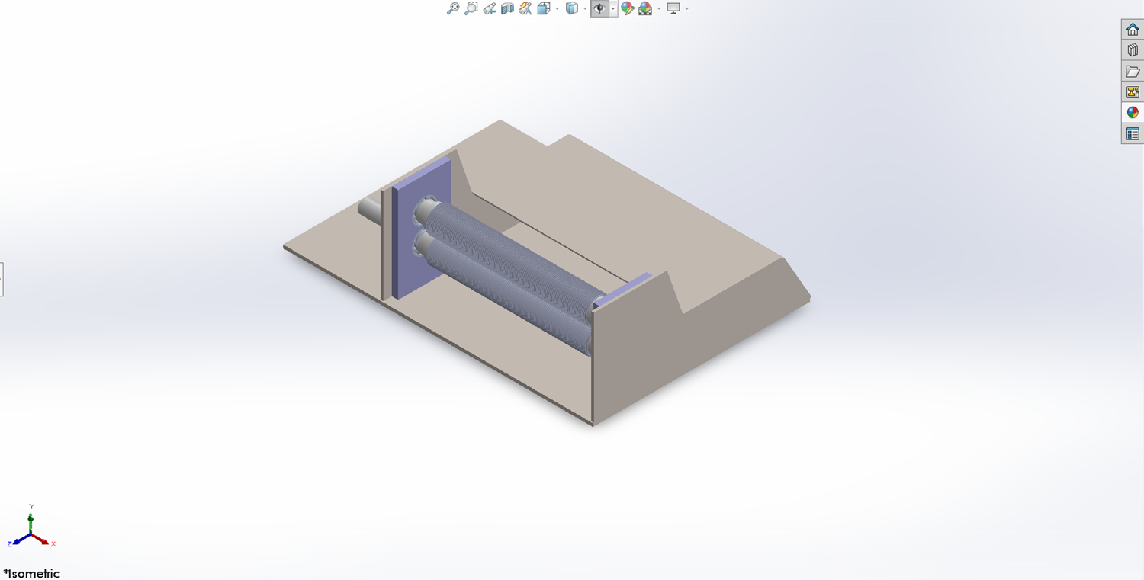
SIDE VIEW

Slide 22
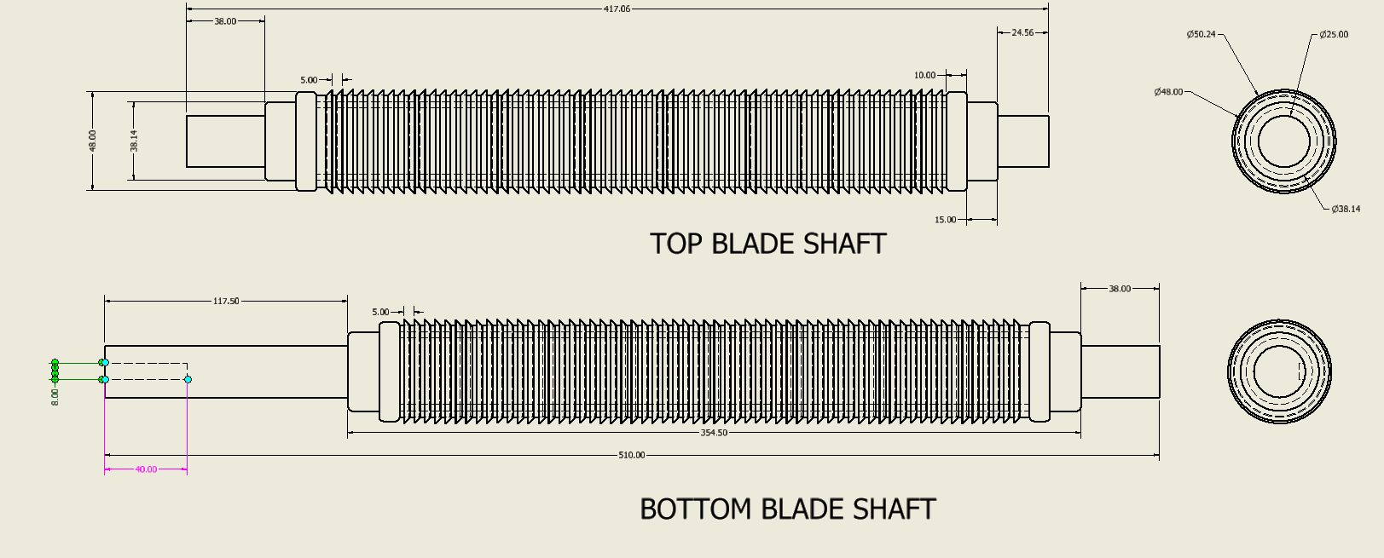
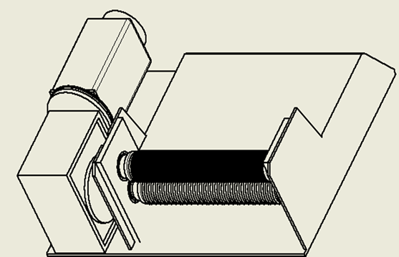

Slide 23
MATERIALS USED
Mild steel (Grade A Corten)
Mild steel is a ferrous metal made from iron and carbon. it is a low-priced material with properties that are suitable for most general engineering applications.
Mild steel has a carbon content of between 0.16% and 0.29 % maximum with a relatively high melting point of between 1450°C to 1520°C.
Corten Steel (grade A) is also known as weathering steel or atmospheric corrosion resistant steel
STAINLESS STEEL(300 Series Austenitic)
Stainless steel is essentially low-carbon steel that contains chromium of 10% or more by weight.
Austenitic 304 and 316 stainless steels are considered surgical or medical-grade stainless steels, they are the most commons stainless steels.

Slide 24
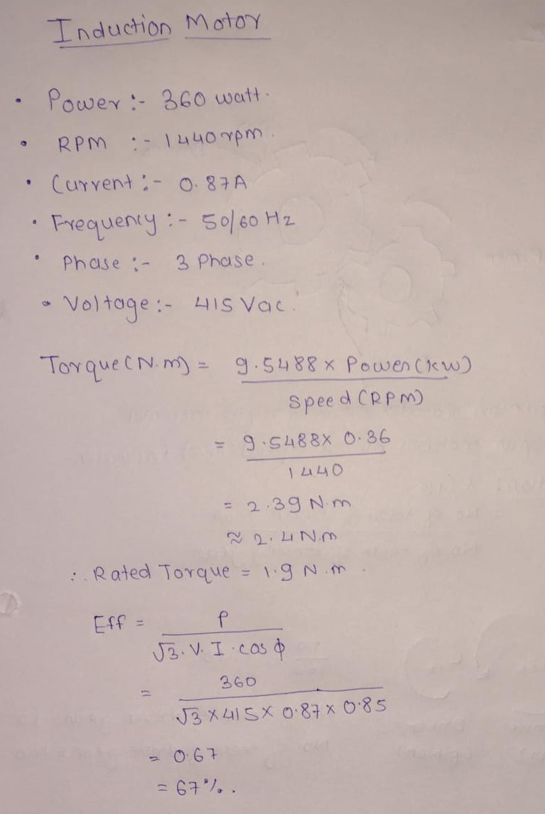
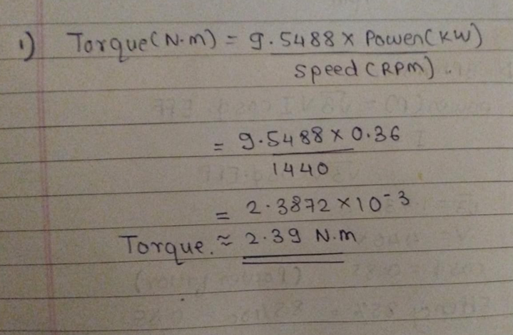
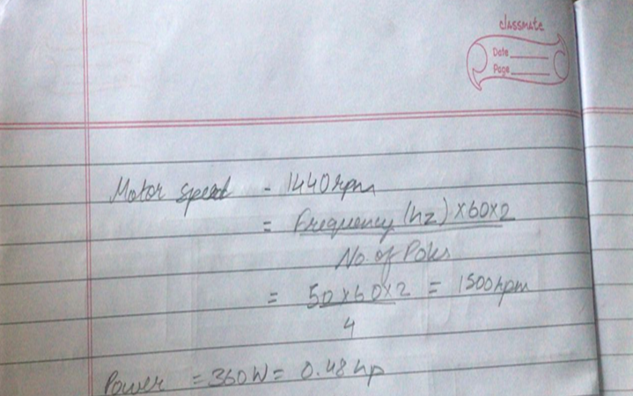

Slide 25
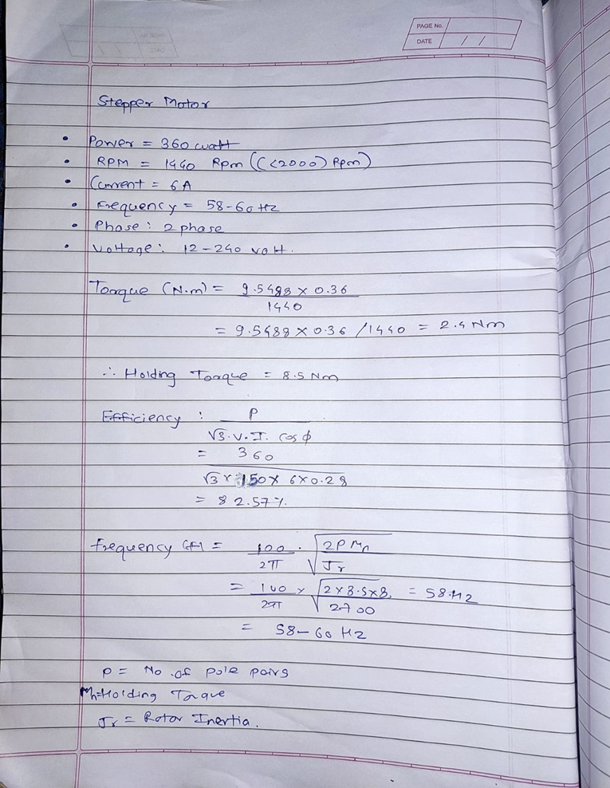
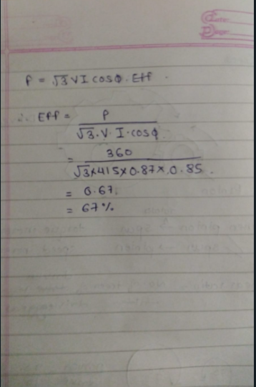

Slide 26
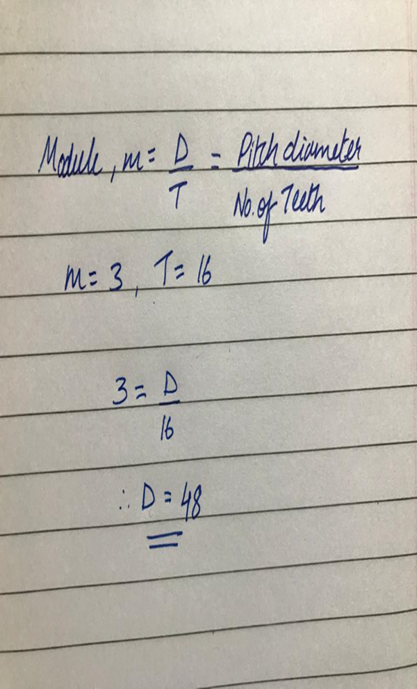
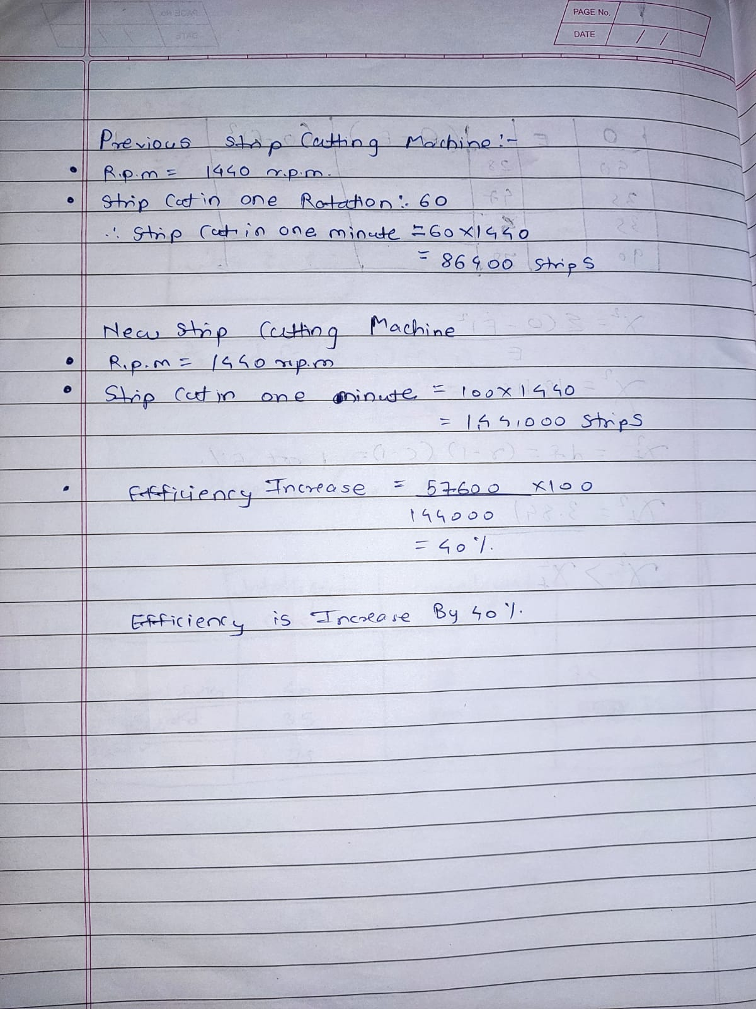
Product efficiency

Slide 27
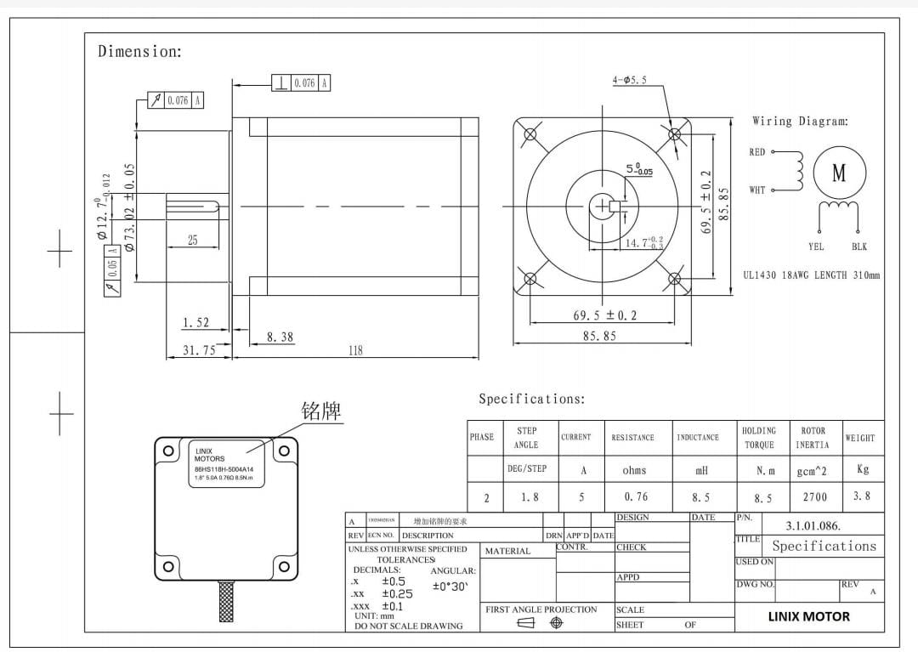
STEPPER MOTOR

Slide 28

Arduino uno R3(Micro-controller) used For controlling stepper motor

Slide 29
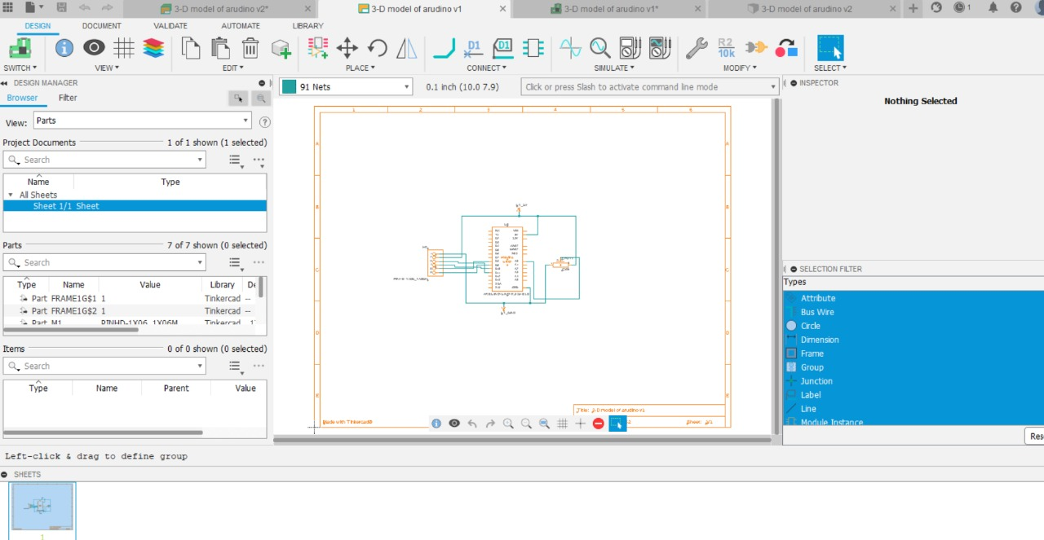
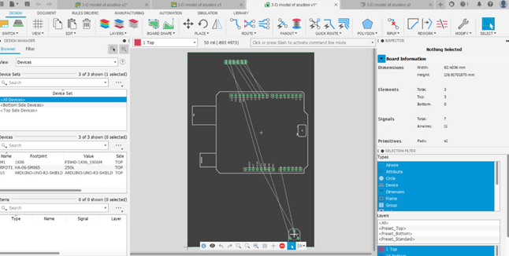
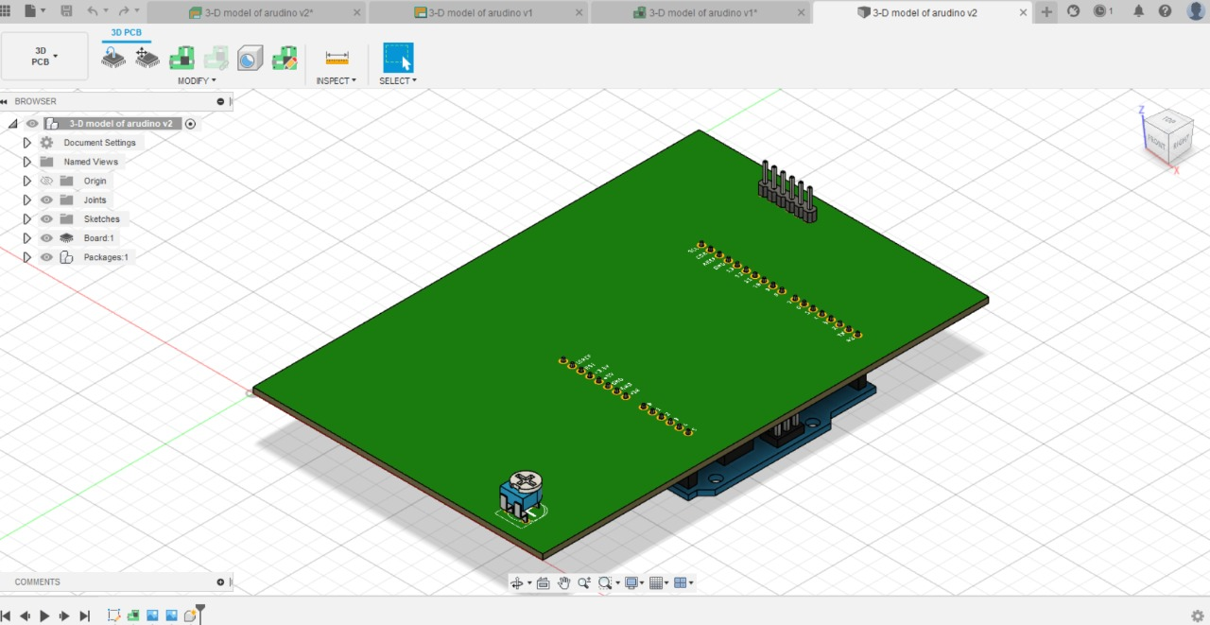
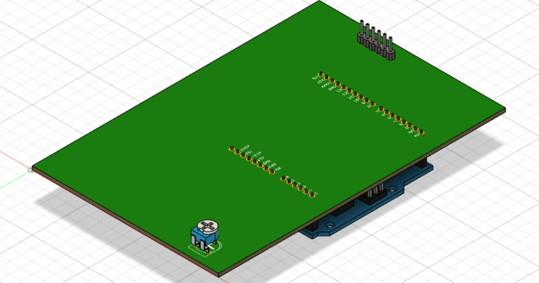
PCB’s For Arduino

Slide 30
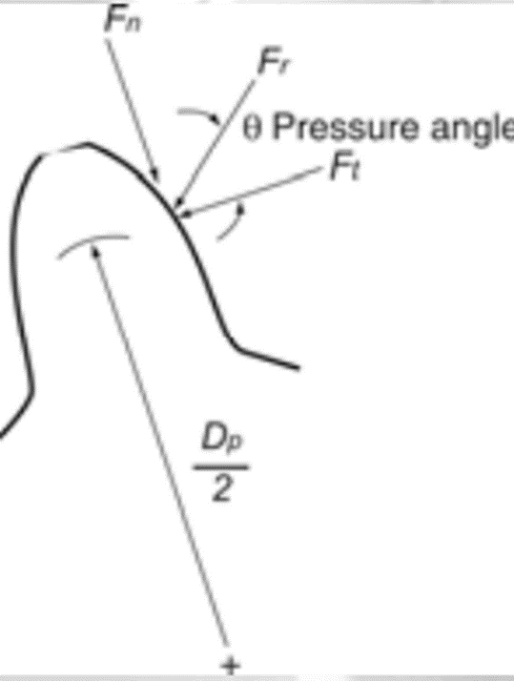
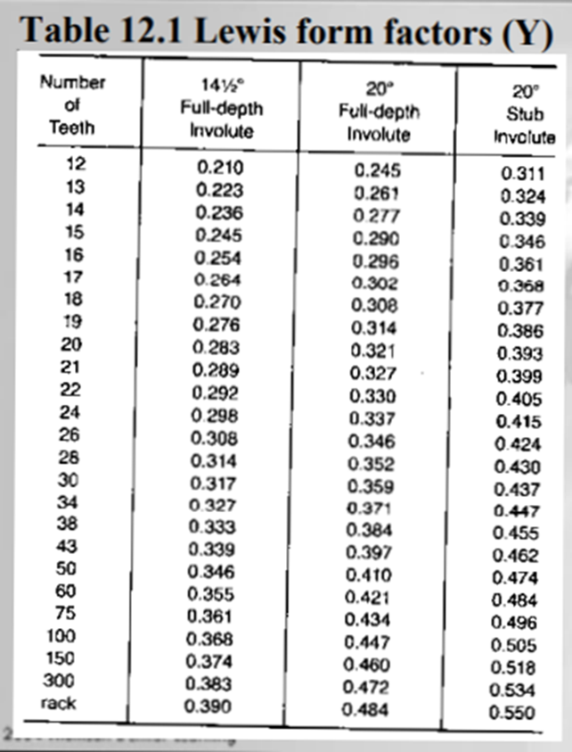
Forces on spur gear teeth
• Ft = Transmitted force
• Fn = Normal force or separating force
• Fr = Resultant force
• θ = pressure angle
• Fn = Ft tan θ
Forces on spur gear teeth
• Power, P
• Torque, T = F(t) r and r = Dp /2 F(t) = 2T/Dp
Combining the above we can write
Surface Speed
Surface speed (Vm) is often referred to as pitch-line speed
Vm = (π Dp n)/1000 m/min ---Metric unit
Fr = Ft/cos θ
Lewis Equation
Fs = (Sn Y b)/Pd
• Fs = Allowable dynamic bending force (lb)
• Sn = Allowable stress (lb/in2).
Use endurance limit and account
for the fillet as the stress concentration
factor
• b = Face width (in.)
• Y = Lewis form factor (Table 12.1)
• Pd = Diametral pitch
Force Transmitted
• Transmitted load depends on the accuracy of the gears
• A dynamic load factor is added to take care of this.
• Ft = Transmitted force
• Fd = Dynamic force
• Commercial
Design Methods
• Strength of gear tooth should be greater than the dynamic force; Fs ≥ Fd
• You should also include the factor of safety, Fs/Nsf >= Fd
Fd = 600+Vm/600 Ft

Slide 31
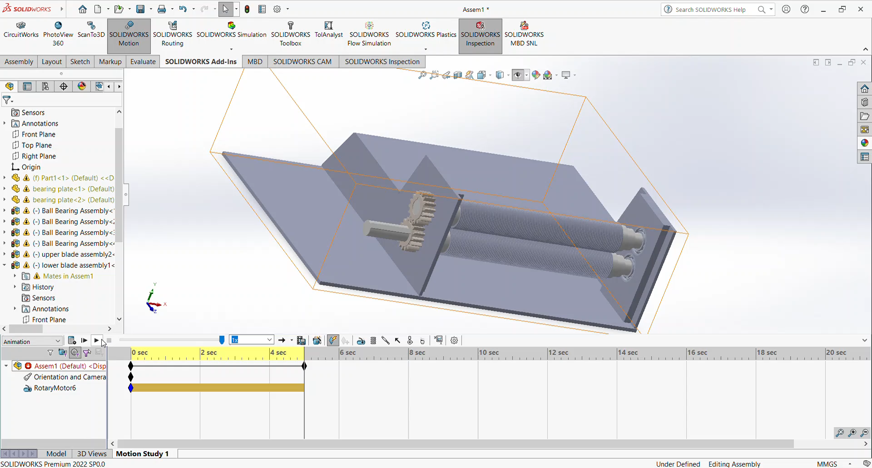
Animation of Machine

Slide 32
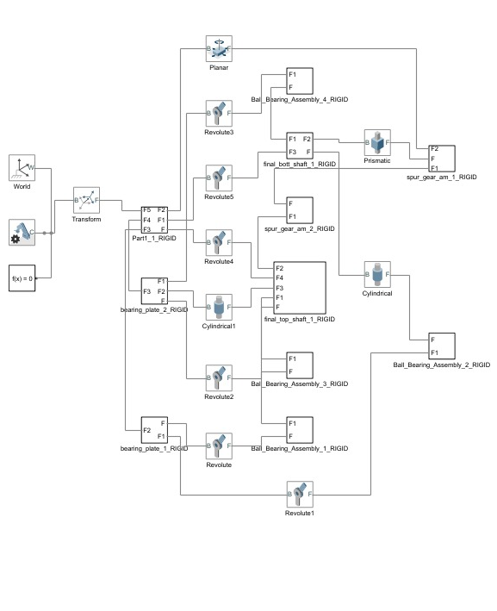
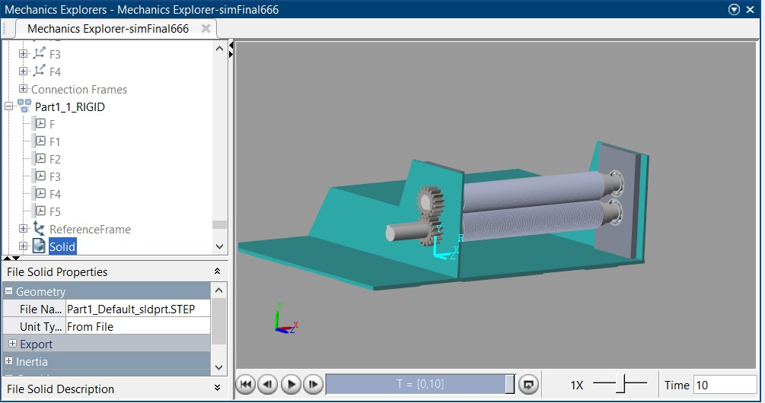
MATLAB INTEGRATION

Slide 33
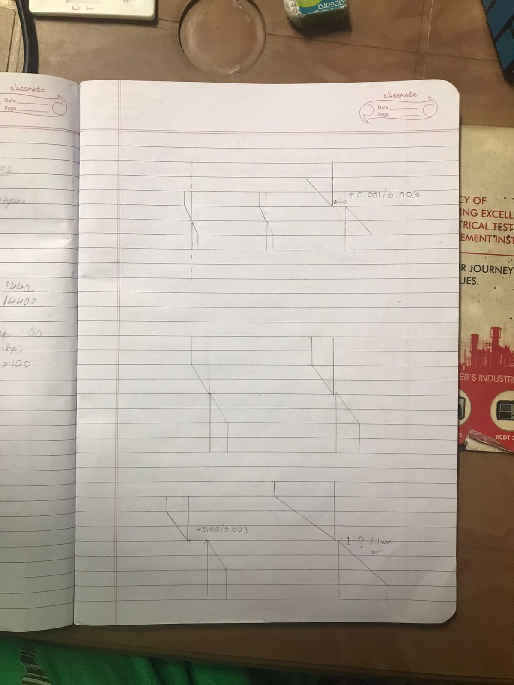
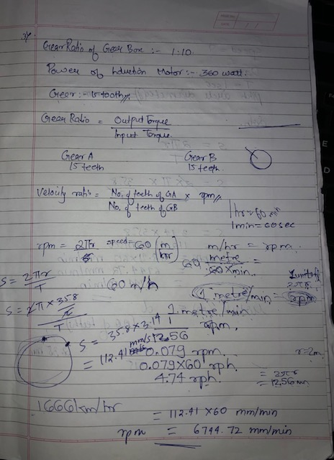
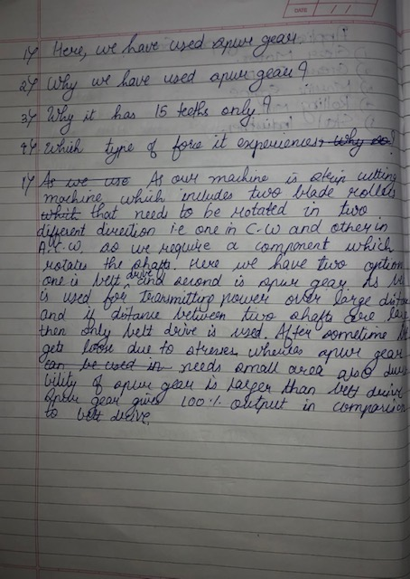
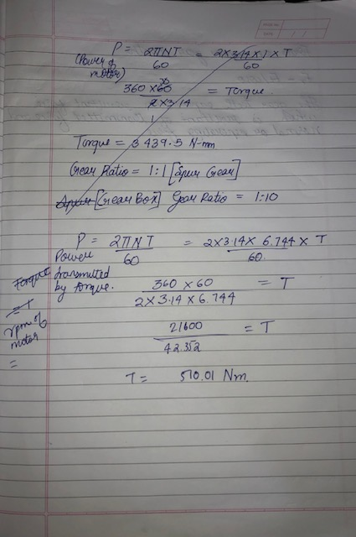
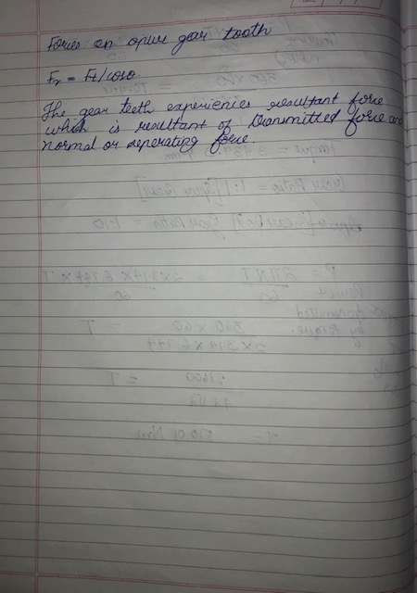
CALCULATIONS

Slide 34
WORK DONE TILL DATE
1. | Completed reverse engineering of Strip Cutting Machine.
2. | Completed `modelling of the existing machine.
3. | Completed analysis of electric component, block diagram of all components of machines.
4. | Learned about Gears, did Analysis of forces on Gears, manufacturing processes, etc.
Next Work plan
1. | Working on Matlab for integration of CAD Model and electric components.
RGIT, Andheri

Slide 35

REFERENCES
References
Kishor Shelke et al, (2018)“Application of Reverse Engineering for converting Cartesian Coordinate System into Laser Cutting Machine.” International Research Journal of Engineering and Technology (IRJET). Volume: 05 Issue: 04.
N Singh, (2008)“Reverse Engineering.” IJAERS/Vol. II/ Issue I.
Prof N.S. Pohokar et al, (2013) “Application of Coordinate Measuring Machine in RE: Case Study.” International Journal of Engineering Research & Technology (IJERT). Vol. 2 Issue 5.
Vishesh Jain et al, (2014) “ Functional Reverse Engineering for Mechanical Components.” International Journal of Advanced Mechanical Engineering. Volume 4, Number 2.
David Sekus et al, (2014) “Integration of Modelling in Solidworks, Matlab/Simulink environments.” VOL. LXI.
Kaushal Khetan et al, (2016) “ Control of Mechanisms and Robots using Labview, Solidworks and Arduino.” .” International Research Journal of Engineering and Technology (IRJET). Vol. 5 Issue 02.
Arduino Fundamentals & Applications – “Prof. Amit Kumar Mishra et al. “
Introduction to material science for Engineers; 8th edition By James F. Shackelford Pearson.
Theory of machine -Khurmi.
RGIT, Andheri
35

